Slide 1
ThingML
A modeling language for embedded and distributed systems

Slide 2
Introduction
Modeling language for embedded and distributed systems
Developed by the Networked Systems and Services department of SINTEF in Oslo, Norway
"Thing" Modeling Language as a reference to the so called Internet of Things
Has a set of code generators to compile ThingML to C, Java, JavaScript
Can be used to generate PlantUML diagrams
Notes:
IoT - internetworking of physical devices, vehicles, buildings and other items—embedded with electronics, software, sensors, actuators, and network connectivity that enable these objects to collect and exchange data

Slide 3
Selected Features
Primitive values
property myProperty : Integer
property myStringProperty : String = "init"
property state : DigitalState
readonly property myProperty : Integer = 16
Composite states
composite state MyCompositeState init InnerState1{}
composite state MyCompositeState init InnerState3 keeps history {}
States
state MyState {
on entry do /* some actions */ end
on exit do /* some actions */ end
}
Messages
message ping();
etc. (Fragments, Ports, Internal Transitions, Parallel regions, Includes)
Notes:
Composite states automatically enter their initial state
Includes = extends, implements, inherits; but it only copy-pastes original object’s code to a new object

Slide 4
Hello World
class HelloThing
thing HelloThing {
statechart HelloWorld init Greetings {
state Greetings {
transition -> Bye
action print "Hello World!\n"
}
state Bye {
on entry print "Bye.\n"
}
}
}
initial Greetings
to Bye
effect

Slide 5
txtUML Translation
package helloworld.x.model;
signal Test;
class HelloThing {
initial Init; state Greetings; state Bye;
transition GreetingsTransition {
from Init; to Greetings;
effect { log("Hello World!"); send new Test() to HelloThing.this;}
}
transition ByeTransition {
from Greetings; to Bye; trigger Test;
effect { log("Bye."); }
}
}

Slide 6
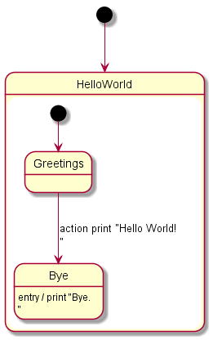
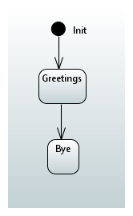
UML Diagrams

Slide 7
Compiling
Prerequisites
Maven 3
Java JDK 7-8
Compilers for other languages (if needed)
Registry jar with all the compilers
java –jar registry.jar -c java -s HelloWorld.thingml
(Other possible arguments include nodejs, UML, posix (C) and more)
Java building
mvn clean package exec:java -Dexec.mainClass=org.thingml.generated.Main

Slide 8
Personal opinion
Pros
Multiple compilers for languages such as Java, C, JavaScript, C++ (for Arduino)
Ability to add custom compilers for other languages
Can generate UML immediately
Cons
Messy documentation all over the internet
Hard to figure out at first
No binaries, only source code which only works with Maven 3
The Eclipse editor plugin is for very old versions of Eclipse
Conclusion
txtUML is a more elegant solution, but it only works with Java and C++
Notes:
Original website uses the word “compiler”, but it is a translator
Can generate UML without having special java classes like in txtUML

Slide 9
References
Fleurey, Franck and Brice Morin. "ThingML Main". Thingml.Org, 2010, http://thingml.org/pmwiki.php.
"SINTEF-9012/ThingML". GitHub, 2010, https://github.com/SINTEF-9012/ThingML https://github.com/SINTEF-9012/ThingML/tree/master/compilers.
"HEADS-Project/Training". GitHub, 2010, https://github.com/HEADS-project/training.

